Slide 1
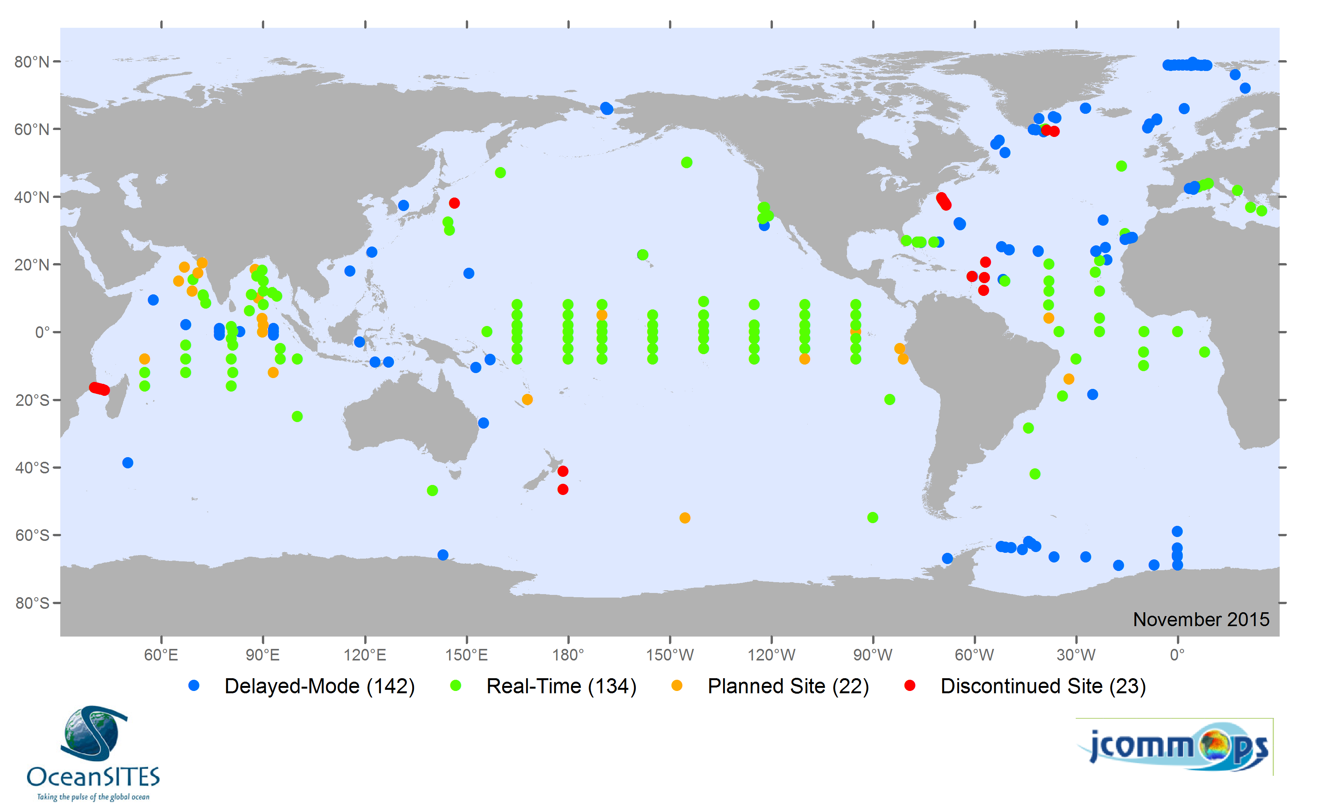
OceanSITES: Electing an Incoming Chair and Executive Committee Members
https://megacities.jpl.nasa.gov/portal/
Diane Stanitski
OceanSITES Program Manager
NOAA Climate Observation Division
National Oceanic and Atmospheric Administration
27 April 2016

Slide 2
OceanSITES Leadership
HUGE thanks to Uwe and Bob for their leadership over the past 17 years!
During Recife meeting, new Governance structure put in place, including new terms for Chairs and Executive Committee members

Slide 3
Opportunities as an OceanSITES Chair
Serve as a leader of our international ocean observing community!
Participate in decision-making for an internationally-recognized and respected group of observing scientists and sites.
Contribute your expertise to advancing and coordinating a worldwide system of long-term, deep water reference stations measuring dozens of variables and monitoring the full depth of the ocean.
Work more closely with an impressive team of scientists and data management specialists!

Slide 4
Membership (as stated in Governance document)
The organizational structure of OceanSITES comprises a Steering Committee (SC) and a Data Management Team (DMT), led and represented by an Executive Committee (EC) and Chairs.
Participation in the OceanSITES bodies is voluntary and without compensation, and the supporting OceanSITES global data assembly centers are provided by organizations involved in OceanSITES.

Slide 5
Chairs (as stated in Governance document)
Co-Chairs lead OceanSITES and chair the Steering and Executive Committees, including:
day-to-day oversight of Technical Coordinator and Project Office activities
setting agendas & organizing meetings for OS committees
potentially nominating external members of the Executive Committee after consultation with the EC
overseeing fundraising from funding agencies, institutions, and other organizations to support OS staff
Co-Chairs are supported and advised by a Post-Chair
3 Chairs represent OS in discussions and joint planning with stakeholders & related organizations across GOOS

Slide 6
Chairs (as stated in Governance document)
Progression from Incoming Chair to Chair to Post-Chair
Terms in each role - up to 3 years (in exceptional cases, a second term can be held)
Meetings of Chairs involve all three people, whenever possible
Decisions should be by consensus, if possible, otherwise by the Co-Chairs following consultation with the Post-Chair

Slide 7
Process to Select Incoming Chair
Nominations for the position of Incoming Chair come from Steering Committee (SC) membership
Persons external to the Steering Committee but that have special expertise or professional qualifications relevant to the position, can also be nominated (by the EC)
SC will be asked to rank nominated candidates (who have agreed to serve in this role), in order of preference in a secret ballot.
The top three choices will be forwarded to a Committee of Stakeholders, who will make the final selection after consultation with the current Chairs.

Slide 8
Nominations/Self-nomination for Incoming Chair
Name:
Affiliation (institution, city, country):
Experience with OceanSITES:
If a self-nomination, why do you want to serve as OceanSITES Incoming Chair?
Do you agree to serve for three-year terms, transitioning to Chair and Post-Chair, represent OceanSITES internationally, and participate in monthly calls to contribute to the evolution of OceanSITES?
Nominations due: Friday, 6 May

Slide 9
Executive Committee
Provides scientific oversight
Initiates strategic, operational, and administrative activities
Responsible for establishment and oversight of working groups
Meets monthly by teleconference and conducts face-to-face meetings on ad-hoc basis
Develops synergies between OS members
Enhances international cooperation and links to other relevant programs in ocean observation
Provides vision, advice, guidance to attract & maintain new OS and making sure community follows OS objectives
Reviews applications for new OS
Responsible for governance, conduct, and identifying funding for special projects (e.g., Deep Ocean observing) undertaken by OS
Provides guidance and oversight regarding the OS website
Helps identify sources of support to fund JCOMMOPS staff

Slide 10
Executive Committee Members
Consists of all Chairs, including DMT Chair, and 5-7 members nominated and elected from within the Steering Committee
Includes broad representation from different OS across ocean basins and disciplines
Chairs can nominate up to two external EC members
Terms of 3 years (with an option to be renewed once)
Expected to help sustain the momentum and management of OS
Must participate in at least half the monthly teleconferences and in-person meetings, and provide input by email if unavailable, else be replaced by a new member

Slide 11
Executive Committee Members
Robert Weller (co-chair), Woods Hole Oceanographic Institution, USA
Uwe Send (co-chair), Scripps Institution of Oceanography, USA
Antje Boetius, Alfred-Wegener-Institute, Germany
Champika Gallage, OS Technical Coordinator, JCOMMOPS, France
Makio Honda, Japan Agency for Marine-Earth Science and Technology, Japan
Richard Lampitt, National Oceanography Centre, United Kingdom
Roger Lukas, University of Hawaii, USA
Vsn Murty, CSIR National Institute of Oceanography Regional Centre, India
Derrick Snowden, Integrated Ocean Observing System, USA
Thomas Trull, University of Tasmania, Australia
Douglas Wallace, Dalhousie University, Canada

Slide 12
Nominations/Self-nomination for Executive Committee Member
Name:
Affiliation (institution, city, country):
Experience with OceanSITES:
If a self-nomination, why do you want to serve on the Executive Committee of OceanSITES?
Do you agree to serve for three years (with an option to renew once), and participate in monthly calls to contribute to the evolution of OceanSITES and willing to serve as a liaison to other ocean observing communities?
Nominations due: Friday, 6 May

